Slide 1

uNit 1 –Introduction to µI
Computing Systems

Slide 2

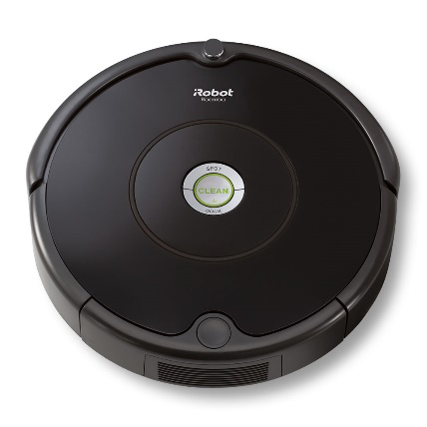


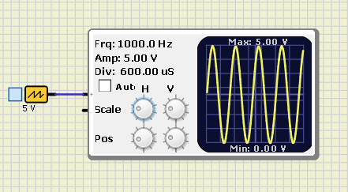
From voltage to logic computing
Font:Lenovo.com
Font:iRobot.es
Font:hispantv.com
Font:lg.com
How is it possible?
...1101000110011
Font:App SimulIDE

Slide 3
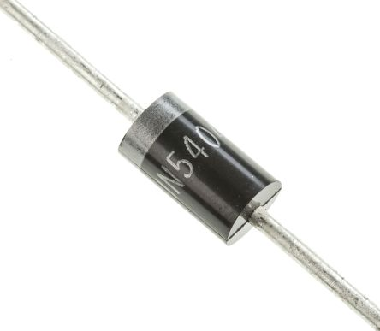
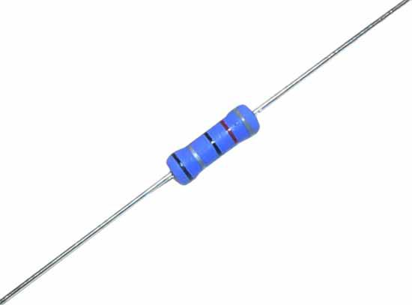
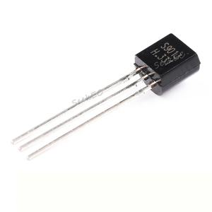
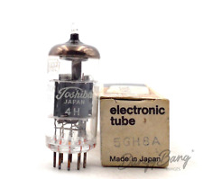
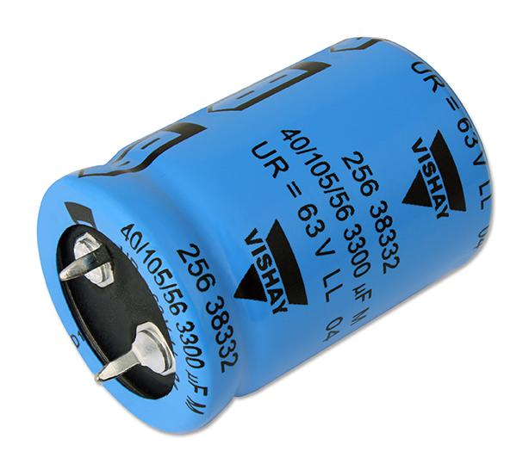
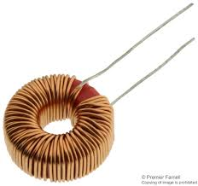
To sum up the starting point
Resistor
Capacitor
Diode
Transistor; History: BJT and Mosfet
Coil
Tube
Font:Farnell.com
Font:ebay.es

Slide 4
















To be voltatge or not to be voltage
Font:radiocampusparis.org
Humans ned fingers to count
Humans have twenty fingers
Decimal is a positional system
Computers ned voltatge to count
Bi stands for two símbols 0 and 1
Binary is a positional system
vs
$$1_{10}$$
$$1_{2}$$
$$\sum_{p=0}^{n}{2^{p}d}$$
$${10}_{10}$$
$$x 10$$
$$\sum_{p=0}^{n}{{10}^{p}d}$$
$${10}_{2}$$
$$x 2$$
$${100}_{10}$$
$${100}_{2}$$
$${1000}_{10}$$
$${1000}_{2}$$
$${10000}_{10}$$
$${10000}_{2}$$
$${10000}_{2}={10}^{4}·1+0+0+0+0$$
$${10000}_{2}=2^{4}·1+0+0+0+0$$

Slide 5
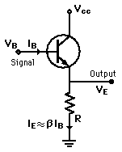
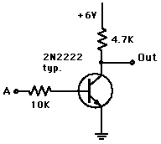
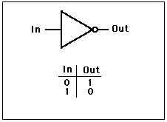
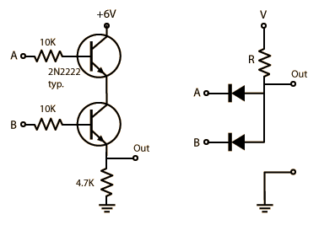
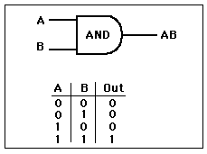
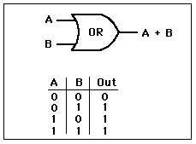
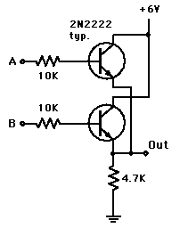
Voltatge to logic: GATES
BUFFER
NOT
AND
NAND
OR
NOR
XOR
XNOR
Font:hyperphysics.phy-astr.gsu.edu/

Slide 6
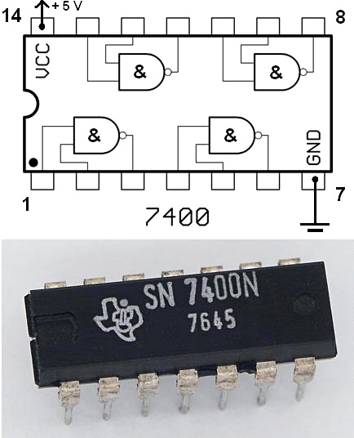
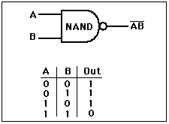
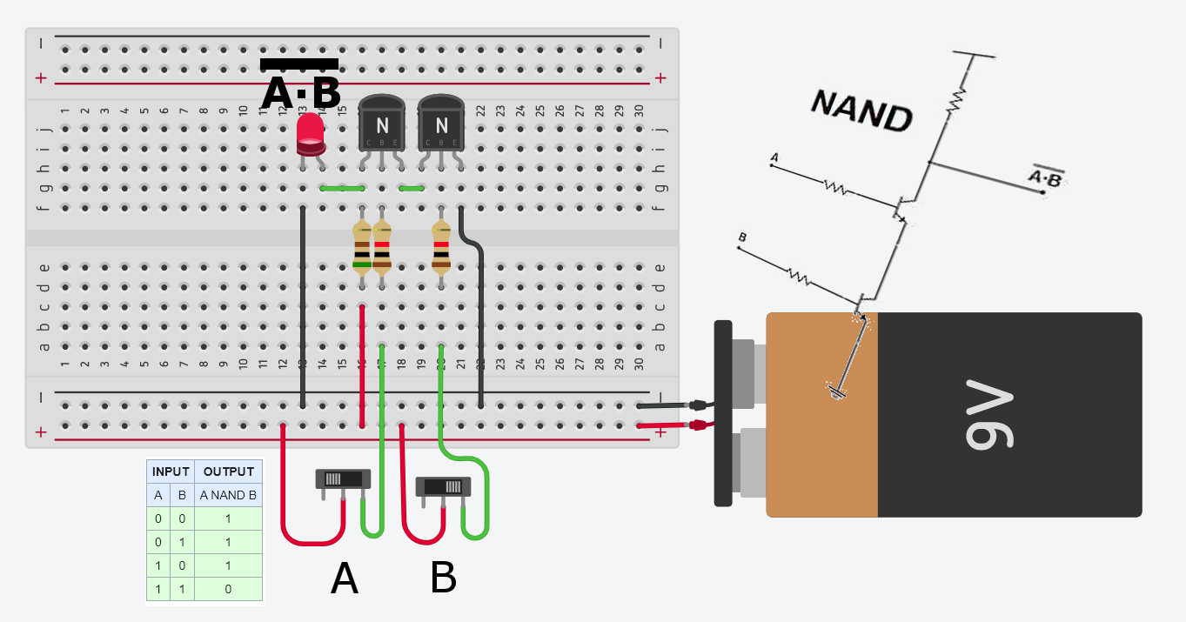
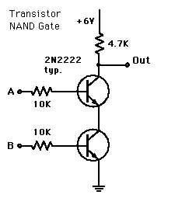
NAND GATE
Font:hyperphysics.phy-astr.gsu.edu/
Font:wikipedia

Slide 7
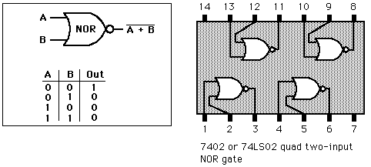
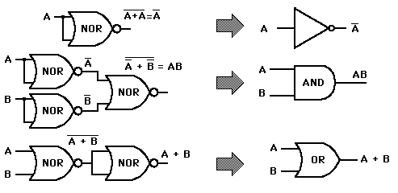
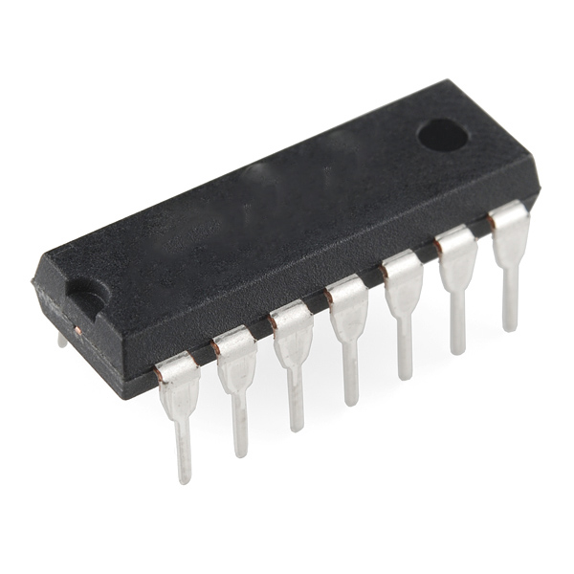
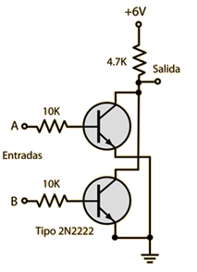
NOR GATE
Font:hyperphysics.phy-astr.gsu.edu/

Slide 8
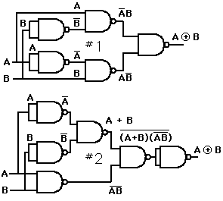
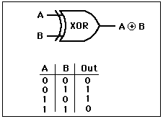
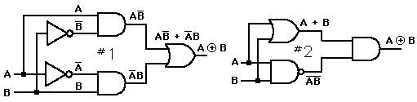
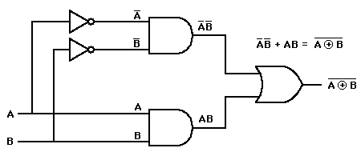
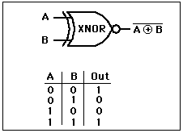
EXCLUSIVE OR GATE (XOR)
WITH NAND
EXCLUSIVE NOR GATE (XNOR)
Font:hyperphysics.phy-astr.gsu.edu/

Slide 9
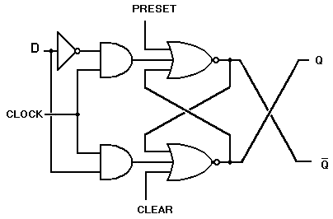
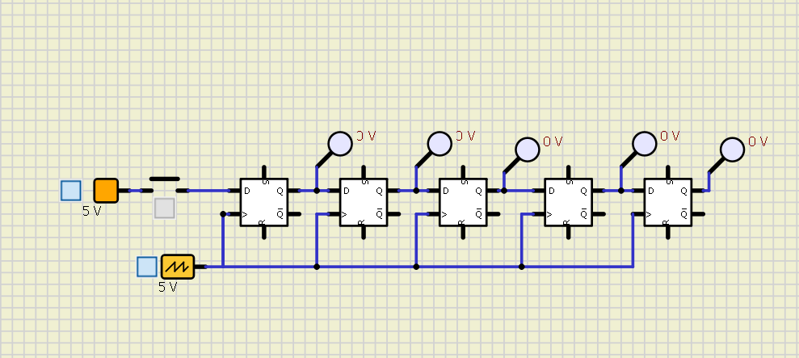
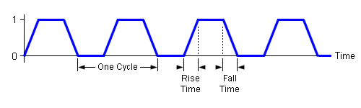
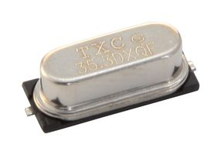
Flip Flop
Has memory!
Q | D | Q_{t+1}
0 | 0 | 0
0 | 1 | 1
1 | 0 | 0
1 | 1 | 1
Font:hispavila.com
CLOCK
Font:farnell.com

Slide 10
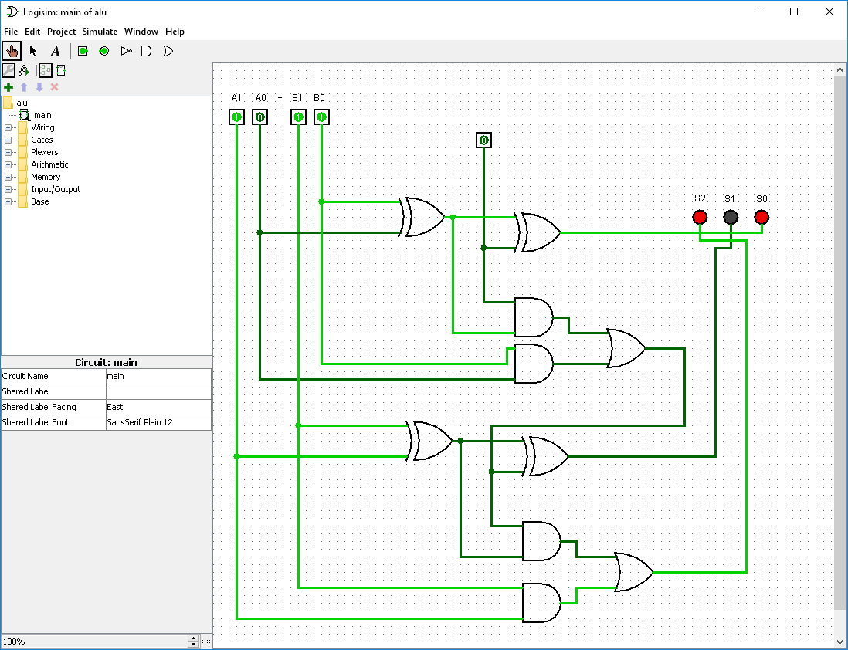
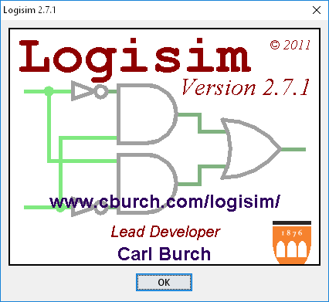
Adder
A
2
3
S
B
2
11₂
10₂
A₁ A₀
+
11₂
+
11₂
+
B₁ B₀
______
______
______
110₂
101₂
S₂ S₁ S₀
0₂₊ 0₂ = 0₂
1₂₊ 0₂ = 1₂
1₂₊ 1₂ = 0₂
Overflow!!!
Carry one

Slide 11
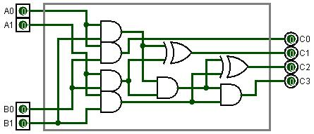
Multiplier
A
2
4
C
B
2

Slide 12
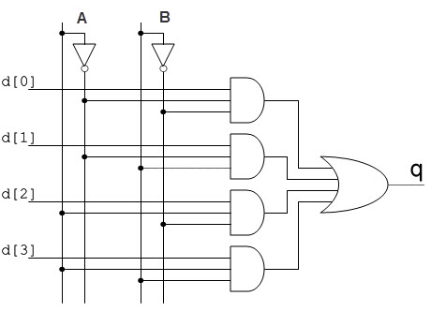
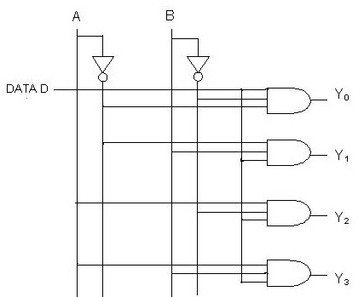
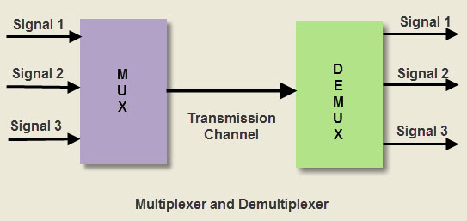
Multiplexer & Demultiplexer
A | B | q
0 | 0 | d[0]
0 | 1 | d[1]
1 | 0 | d[2]
1 | 1 | d[3]
A | B | Y₀ | Y₁ | Y₂ | Y₃
0 | 0 | 0 | 0 | 0 | 1
0 | 1 | 0 | 0 | 1 | 0
1 | 0 | 0 | 1 | 0 | 0
1 | 1 | 1 | 0 | 0 | 0

Slide 13
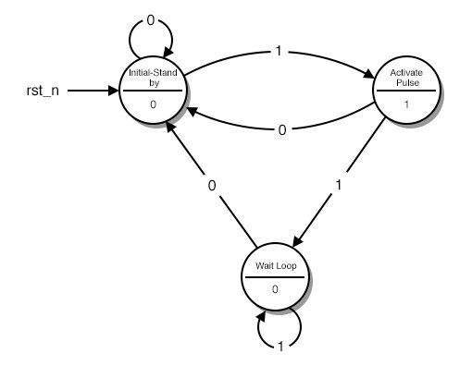
State machine
Algorithms
Flip-flops has memory in a sequentially Systems.
Combinational Systems can create logical funcions.
Clocks and counters fix the states and sequency.
Sequences of states
dependent on a set of
input variables
Font:allaboutcircuits.com

Slide 14
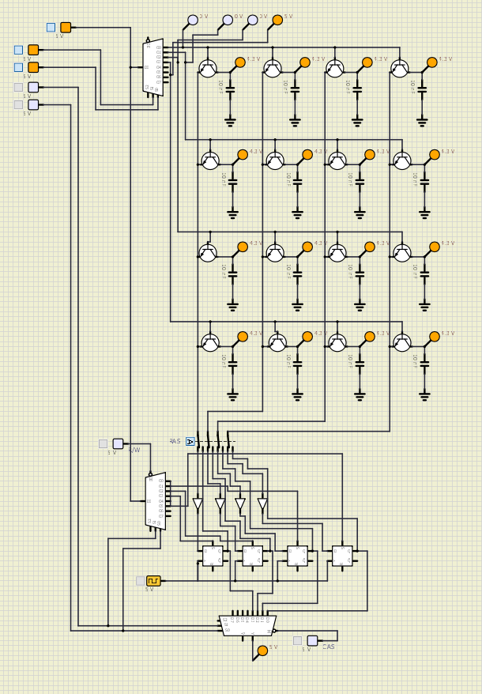
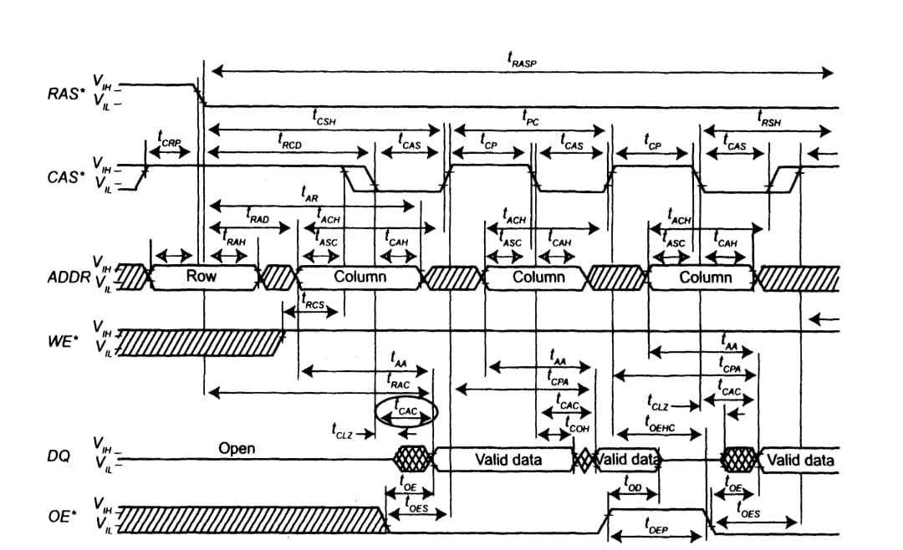
Dinamic Random Acces Memory
DRAM is an array designed for density.
Address neds n bits; n/2 for rows and n/2 for columns
Signals to control columns and rows CAS ans RAS.
Signals to enable write or read and data out or in.
Signal from clock.
Can’t hold data without power.
A₀
A₁
A₂
A₃
MAIN
MEMORY
$$2^{n} x b=16 x 8=128 bits \underset{↔}{} 16 Bytes$$

Slide 15
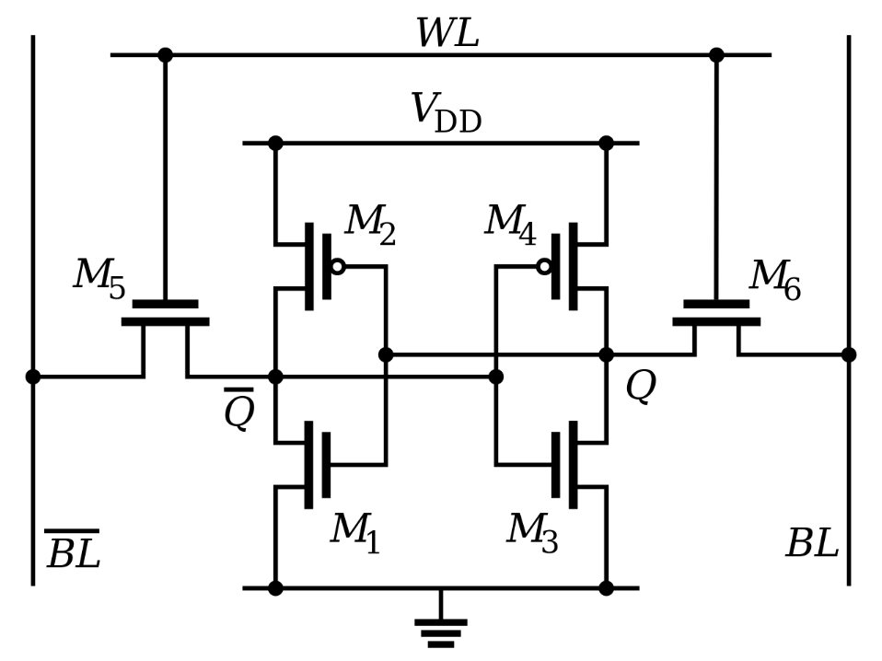
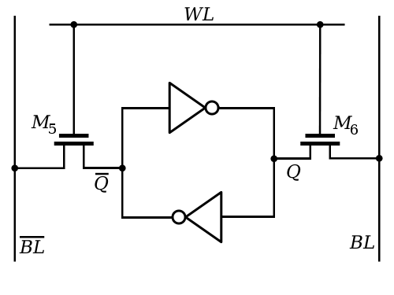
Static RAM Memory
4 transistors per bit and 2 more per port.
Does not need to be refresh but voltatge must be applied.
Designed for velocity.
What the diference beetwen RAM and SRAM

Slide 16

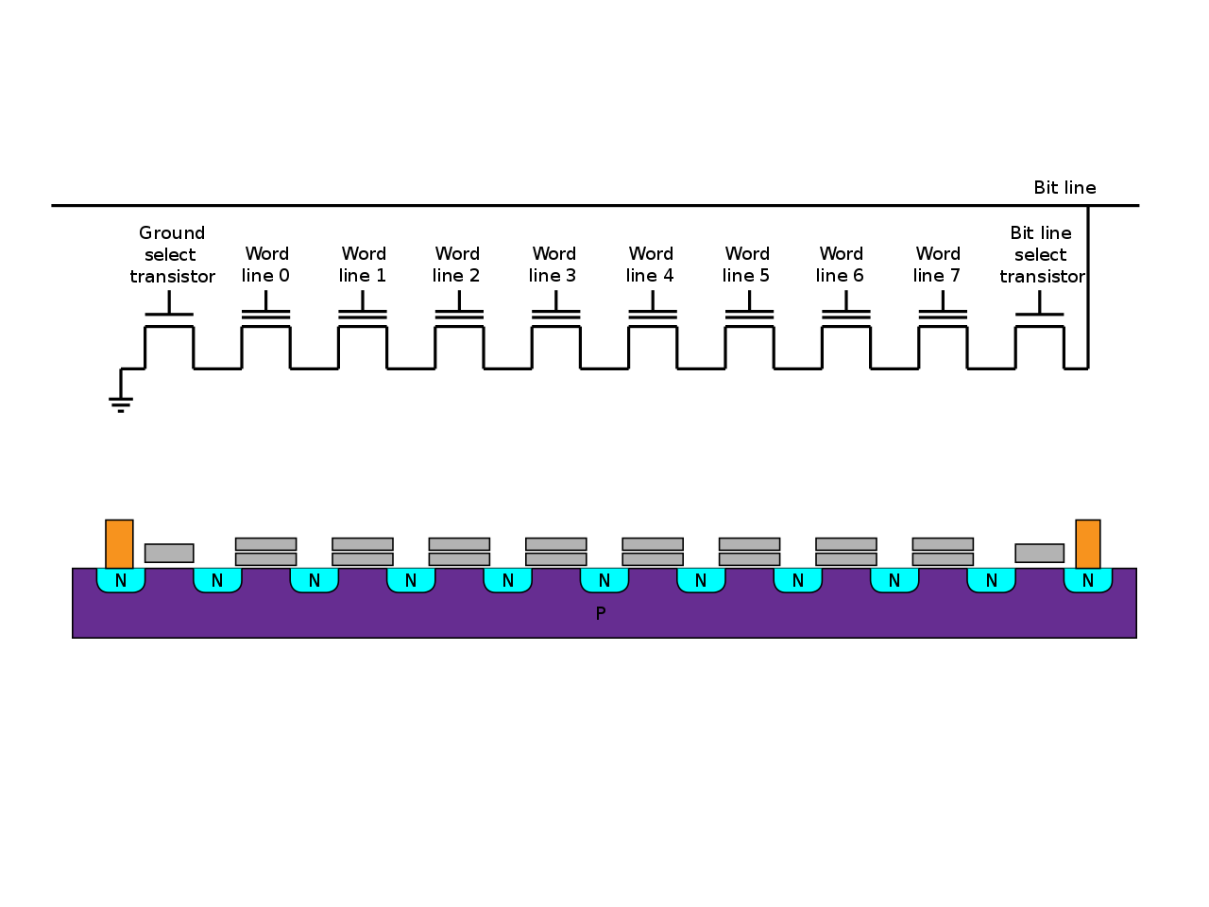
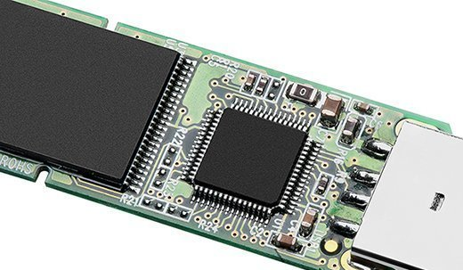
Flash Memory
Acces sequentially.
Hold data without power.
Made with NAND gates.
One transistor per bit.
Data has to be erased in entire blocs but in one flash!
Font:wikipedia

Slide 17

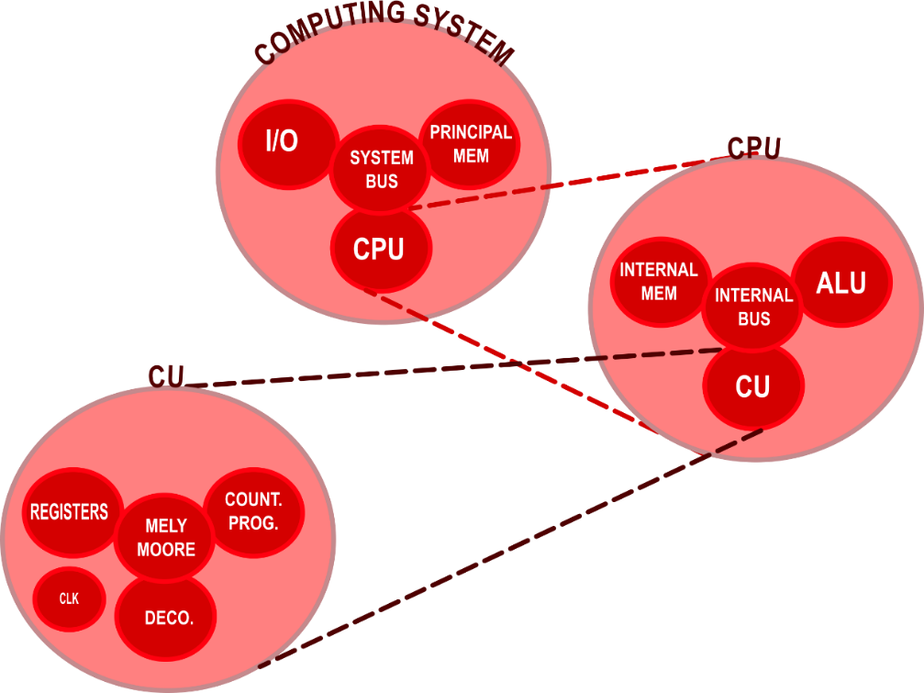
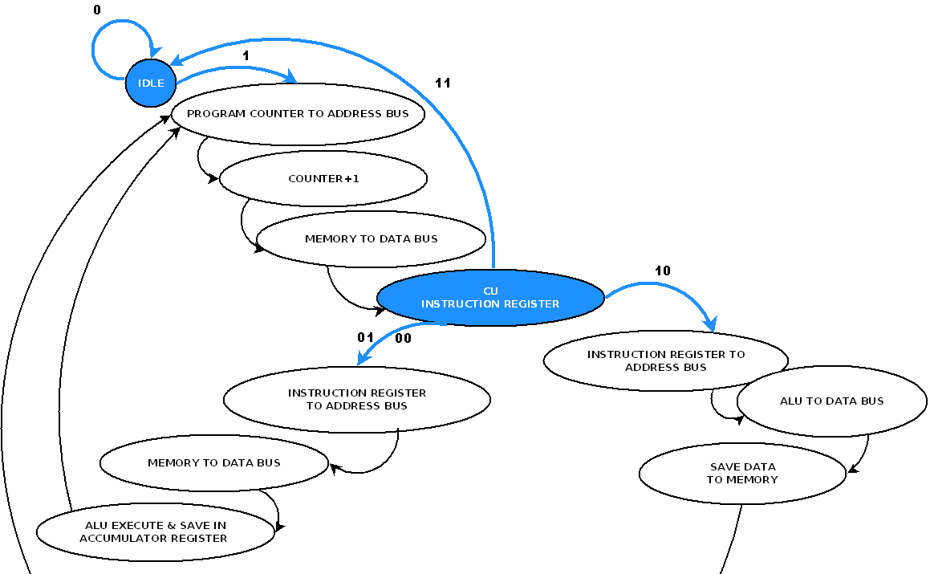
Architecture Von Neumann
A System BUS combining the functions of a data bus, an address bus, and a control bus.
Principal Memory is connected to a Control Process Unit and I/O through a System BUS.
A simple CPU consists of a Control Unit and an Arithmetic Logic Unit.
CU can be a state machine or it can be programed.
Test it!

Slide 18
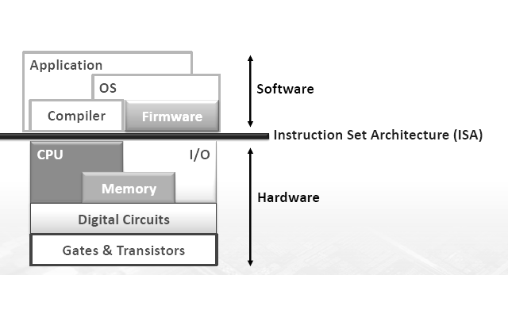
Computing System in layers
Software is programmed with human-friendly code.
The Compiler or interpreter transforms human-friendly code into binary code that represent data and instructions.
An instruction set are the instructions that the CPU can execute to do his work. It can be software or low level hardware control also called Firmware.
Font:uc university
If the software can change, how does the CPU know
what to do when the system is turned on?

Slide 19

CISC vs RISC
C
Today’s ISAs are actually targeted to one language. C programming language is very low level.
Object Code
Machine Language
$$Performance=\frac{Instructions}{Program}· \frac{Cycles}{Instruction}·\frac{Seconds}{Cycle}$$
COMPILER
CISC (Complex Instruction Set Computing)
Reduce “instructions/program”.
Tends to increase clock period.
Easy for programmers.
RISC (Reduced Instruction Set Computing)
Improve “cycles/instruction” with many single-cycle instructions
Increases “instruction/program”, but hopefully not as much
Help from smart compiler.
Perhaps improve clock cycle time (seconds/cycle) via aggressive implementation allowed by simpler instructions.
ASM
Assembly is any low-level programming language in which there is a very strong correspondence between the instructions in the language and the architecture's
machine code instructions.
ASSEMBLER

Slide 20


Basic Input Output System (BIOS)
Originally the BIOS is a little firmware stored in a non volatile read only memory (ROM). The modern BIOS contents are stored on flash memory.
The user can interact and change some parameters that are hold while the battery has power.
The modern BIOS contents are stored on flash memory.
To performance a system check.
To find loader to init a boot.
PROM→Progamable ROM only once.
EPROM→Erasable PROM all cells with ultraviolet light.
EEPROM→Electrically EPROM only bytes addressed are updated.
Font:tecnologia-informatica.com

Slide 21



The Bootloader
Program is a list of instructions.
Loader is a program routine that copies an executable program into main memory for execution.
The assembler gives the object code.
Font:macfixit.com.au
Hard Disck Drive
Two Bytes
Hexadecimal
Try to make a bootloader with NASM and QEMU
Code system with base 16
0123456789ABCDEF
[BITS 16]; It works with 16 bits
[ORG 0x7C00]; Source where the bootloader is loaded into RAM
...
TIMES 510 - ($ - $$) db 0; Fill the rest of the sector with zeros
DW 0xAA55; Put this sign (little-endian 0x55AA) at the end of bootloader

Slide 22



Operative System
Linux, Why not?
His Kernel is programed with low level language to interacts with the hardware.
OS Needs :
A filesystem in a memory space as a tree.
Sofware Daemon controller: i.e Init.d or System.d
Daemons or processes with memory stack.
Graphical server: i.e X11
Desktop
Applications
Font:softzone.es

Slide 23
To finish....
Thanks!

